Slide 1
File I/O
Notes:
Welcome back, everyone! You know all those python programs that you wrote and saved onto your computer’s hard disk? Those programs are actually stored in what is known as a file, and the cool thing about files is that after you switch off your computer and turn it back on, everything you wrote is still there.
Files can store all kinds of information, from python programs and PowerPoint presentations to sound clips and movies. In this lesson, we will discover how python programs can both read from and write to a file, so that you can do lots of nifty stuff. This is known as file input/output, but all the cool kids call it “File I/O” for short.

Slide 2
Objectives
At the end of this lecture, you will ….
Be able to read and write text files
Build in open() function in Python
Read files
Write files
Notes:
There are a lot of different kinds of files, and we won’t be able to cover everything there is to learn about files in this lesson. Instead, we will focus primarily on text files, which are files that contain characters. Specifically, we will learn how you can access a text file using the open() function, so that you can read text from it and write text to it.

Slide 3
File Type
A file is categorized as either text or binary, and the difference between the two file types is important
Text files
Structured as a sequence of lines, where each line includes a sequence of characters
Each line is terminated with a special character, called the EOL or End of Line character
Binary files
Consists of a sequence of bytes
Can only be processed by an application that understands the file’s structure
Notes:
A file is either a text file or a binary file depending on the information that it contains.
Text files contains lines of text, and are usually human-readable, so you could open a text file with a text editor like Notepad and be able to read and understand what it says. Each line consists of a sequence of characters, which could be letters, numbers, symbols or certain special characters. And at the end of each line, there is usually a end-of-line (or EOL) character to signify the end of the line. If this is all a file contains, it’s a text file.
A binary file is essentially a non-text file. Instead of containing human-readable characters, it contains a sequence of bytes, which is essentially a binary code made of a bunch of ones and zeros. In general, you can’t just open a binary file with a text editor to see what the file contains. Instead, you need some specialized program that understands the file’s structure to make sense of the information. For example, image files are binary files stored in a specific format, such as jpg or bmp. If you open an image file with a text editor, it won’t work. To see the image, you will need a special program such as MS Paint that can understand the file format in order to display the image.

Slide 4
Activity 1
Text or Binary File?
Movie files, e.g., .avi, .mov, .mpg (binary)
Program code, e.g, .py, .c, .cpp (text)
Configuration files, e.g., .cfg, .ini (text)
MS Office files, e.g., .docx, .xlsx, .pptx (binary)
Hypertext files, e.g., .html, .css (text)
Notes:
OK, let’s do a quick activity to make sure you understand the difference between a text file and a binary file. The extension of a file, which are the letters after the dot at the end of the filename, indicates the type of file it is. For the following common file formats, state whether they are a type of text file or a type of binary file. You have movie files like avi, mov or mpg; program code like your python files, C files or C++ files; configuration files that often have extensions like cfg or ini; MS Office files such as your Word, Excel or PowerPoint documents; and your hypertext files such as html or css. What do you think?

Slide 5
File I/O
open function is a Python built-in function that returns a file object.
File objects contain methods and attributes that can be used to collect information about the file and can be used to manipulate the file.
Notes:
OK, now let’s see how python handles files, specifically text files.
The first thing that we need to do is to have something that tells the program which file we are trying to access. For this purpose, python has the built-in function called open(), which returns a file object. The file object provides a bunch of useful functions that we can use to manipulate the file. Let’s see how this works.

Slide 6
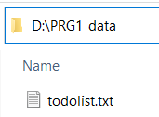
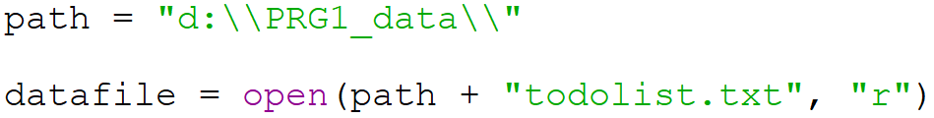
open() function
Usage file_object = open("filename", "mode")
The modes are (not exhaustive):
'r' – Read mode - used when the file is only being read
'w' – Write mode - used to edit and write new information to the file
(any existing files with the same name will be erased when this mode is activated)
'a’ – Append mode - used to add new data to the end of the file; the old data is not removed
Example, to read a file todolist.txt
Notes:
The open function takes in two parameters, both of which are strings. The first parameter is the name of the file to open, while the second parameter is the mode of operation. Assuming nothing goes wrong, the open function will return a file object, which you can assign to a variable as usual.
The filename is pretty straightforward: it’s just the name of the file. If the file is in the same directory as the python program file, then you just need to provide the filename, but if it is in some other directory, you will need to give the full pathname.
The second parameter is the mode, which describes what you are going to do with the file. There are several available modes, but at this point we will look at the three most common ones. Read mode, represented by the letter r, is used when you only want to read the file without changing its contents. Write mode, denoted by w, is used when you want to write to a file, and any existing file with the same name will be erased. However, if you do not wish to erase the existing file but want to add on to the file, then you should instead use append mode, represented by the letter a. In this mode, anything you write will be added to the end of the existing file.
For example, suppose you have a file called “todolist.txt” that resides in the PRG1_data folder in D drive, and you want to read this file. Here is what you might do. Since the file is not in the same directory as the python program file, you will need to provide the full path. One common practice is to have a separate string variable that contains the path, in this case it’s d double backslash PRg1_data double backslash. Why double backslash? Remember when we were talking about escape characters for strings? Well, the escape character for the backslash character is two backslash characters. Crazy, I know. Anyway, with the path variable properly initialized, we can use path + “todolist.txt” to create the full pathname for the file as the first argument to the open function. Since we want to read the file, the second argument is “r” for read mode. Finally, we assign the result of the function to our variable datafile.
Let’s look at the python code example: it opens and reads a file “todolist.txt” in the directory “c:\TodoList” and display the file contents. Notice that double backslash ( \\ ) is used in the path. This is because ( \T ) is treated as the tab special character ( \t ) and error is raised of invalid address. As long as there is a single backslash ( \ ) in the filename, you need to replace it with double backslash ( \\ ) to prevent the characters in the filename string to be treated as special character.

Slide 7

Reading Text from a File
Using a for loop to read a file:
Other ways to read a text file in Python
file.read() - extract a string that contains all characters in the file.
file.read(5) - read the next five characters of stored data and return it as a string.
file.readline() - return the next line of the file
Notes:
OK, we’ve obtained the file object. What can we do with it? Quite a lot, actually. First, let’s see how we can read text from the file.
The simplest way to read a file is to use a for loop. Suppose you have a file object called datafile, you can use a for loop to read it line by line. In each iteration, the variable line will contain a single line in the file, which includes the end-of-line character. So if you want to print out the line, you will have to specify the end character as an empty string, otherwise you will have an extra blank line between each line. Try it and see.
There are times where you do not wish to read the entire file line by line, and python provides some other ways to read a file. Given the file object, the read function will grab the entire file and return it as a single gigantic string. Or you could specify the number of characters to extract, so file.read(5) would read and return the next five characters from the file as a string. You could also use readline() to return the next line of the file. Note that the file object keeps track of the position of the file that was last read, so if you call readline several times, each call will return the next line.

Slide 8
Activity 2
Create a text file called todolist.txt using Notepad that contains the following text:
Save the file in a known directory, e.g., d:\PRG1_data\todolist.txt
Write a python program to read the file line by line and print the contents of the file to screen
To do:
- Prepare lecture slides
- Narrate lecture slides
- Laugh at jokes
- Upload to MeL

Slide 9
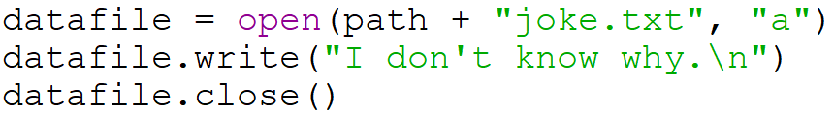
Writing Text to a File
Creating a new file or overwriting an old file:
Writing to a file:
Appending to an existing file:
Notes:
Writing text to a file is also pretty easy. As usual, the first thing you need to do is to obtain the proper file object, except that you need to set the correct mode. If you wish to create a new file or overwrite an existing file with the same filename, use write mode denoted by the letter w. In this case, if there is an existing file called joke.txt in the PRG1_data directory, it will be erased and become an empty file.
Once you have the file object, just use the write function to write text to the file. The write function only accepts string arguments, and it will write the string to the file. Note that if you want to advance to the next line, you have to put in backslash-n at the end of the line, which is the escape sequence for end-of-line.
What if you want to add on to the file rather than replace it? Then you should call the open function using the append mode, denoted by the letter a. In this case, datafile will also refer to the file joke.txt, but the old data will remain. Subsequent calls to the write function will instead add the text to the end of the file.

Slide 10
File close()
Closes the opened file
file = open("filename.txt", "r")
…
…
file.close()
A closed file cannot be read or written to anymore
Python automatically closes a file when the reference object of a file is reassigned to another file.
It is a good practice to use the close() method to close a file.
Notes:
So, did you notice an extra line of code that I added to the previous slide? What’s this file.close() business? Well, the close() function (surprise, surprise) closes the file. This tells the program that we are done reading or writing to the file and to finalize all the changes. A closed file object cannot be read or written to anymore.
Python automatically closes a file when its file object is reassigned to another file, but it is always a good practice to use the close() function to close a file explicitly once you are done with it. There are many reasons why this is a good idea. One reason is that when writing to a file, the data may not be written to disk until the file is closed. The data is often held in memory and doesn’t actually write to the hard drive until the file is closed. Another reason is, some operating systems treat open files as locked and private. While you have a file open, other programs cannot open it and therefore can’t even read the data. Also, the data of an open file is normally held in a temporary memory location. When you close the file, it frees up the memory so that it can used for other purposes.
The moral of the story is: close your files once you’re done with them. Don’t be lazy.

Slide 11
Activity 3
A coffee shop’s prices is given in the following list:
Write a python program to read this list and create a text file called prices.txt that contains the following text:
prices = [ ["kopi", 0.4], \
["teh", 0.4], \
["milo", 0.5], \
["soft drinks", 1.20] ]
kopi: $0.40
teh: $0.40
milo: $0.50
soft drinks: $1.20

Slide 12
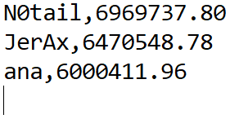
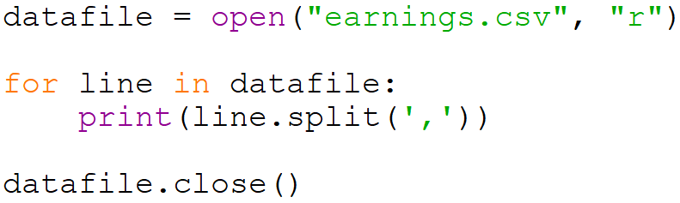
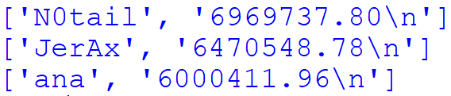
What is Stored in a Text File?
Suppose we have a text file earnings.csv :
Let’s run this program:
Output:
Notes:
Before we end this lesson, let’s examine what is actually stored in a text file a little more closely. Suppose we have a text file called earnings.csv containing this text. “csv” stands for comma-separated values, which is a simple standard format that says that the values in the file are separated by commas. In this case, we have the top 3 professional esports earners, like N0tail who has made 6.9 million US dollars playing DOTA2. Wait, is this right? 7 million bucks playing a video game? I’m in the wrong job.
Anyway, to get a better understanding of what is contained in a text file, let’s run this program. If you recall, split() is a string function that creates a list out of a string by separating each item using the given delimiter character. In this case, we specify a comma as the character, so this code will open the file, read each line, create a list out of each line using split and print out the result. And of course, we close the file afterwards.
This is the output. You will see that each line is split into 2 items. Note that both items are strings, which you can tell by the single quotes. So if you want to read an integer or a float from a file, you must remember to convert it to the correct type afterwards. The other thing to note is that the second item ends with a backslash-n, which is the escape sequence for enter. It is important to remember that text files always have this invisible end-of-line character at the end of every line, because this will affect how you code.

Slide 13
Summary
In Python, you do not need to import a library in order to read and write files. It is handled natively in the language with the built-in open function
Read mode (‘r’);
Write mode (‘w’)
Append mode (‘a’)
Use a for loop, read() or readline() to read a file
Use write() to write to a file
Remember to close() the file when you’re done
Notes:
And that’s all there really is to it. With a little imagination, you can do a lot with just text files, saving your information to disk and reading it again later. To do so, you just need to use python’s native open function with the correct mode, either read mode for reading files, write mode for creating new files or overwriting old files, or append mode to add more text to the end of an existing file. You can use a for loop to read a file line by line, or the read or readline functions to read parts of a file. As for writing to a file, just use the write function. And always remember to close the file when you’re done.
By the way, do you know what is a dinosaur’s favourite type of file? A rar file.

